Slide 1
FAKE NEWS CLASSIFICATION
PRESENTED BY:
RUTUJA PATIL

Slide 2
INDEX
Overview
Problem Statement
Problem Understanding
What is Fake News Classification?
Importance of Fake News Classification?
Exploratory Data Analysis
Visualizations
Analysis
Data Cleaning Steps
Model Building
Hyper Parameter Tuning
Saving model & predictions for Best Model
Conclusion
Test Prediction.

Slide 3
OVER VIEW FOR PREDICTION
In this Presentation we will be looking on the :
How to analyze the dataset of Spam Classifier.
EDA steps in cleaning the dataset.
Overall analysis on the problem.
Model building from the train dataset.
Predicting on the Data Set.

Slide 4
PROBLEM STATEMENT
Fake news has become one of the biggest problems of our age. It has serious impact on our online as well as offline discourse. One can even go as far as saying that, to date, fake news poses a clear and present danger to western democracy and stability of the society.
ABOUT DATA SET
You can find many datasets for fake news detection on Kaggle or many other sites. I download these datasets from Kaggle. There are two datasets one for fake news and one for true news. In true news, there is 21417 news, and in fake news, there is 23481 news. You have to insert one label column zero for fake news and one for true news. We are combined both datasets using pandas built-in function.
PROJECT CONTAINS TWO PHASE
TRAIN DATA SET
TESTING ON THE SAME DATA-SET

Slide 5

WHAT IS FAKE NEWS CLASSIFICATION?
Fake news's simple meaning is to incorporate information that leads people to the wrong path. Nowadays fake news spreading like water and people share this information without verifying it. This is often done to further or impose certain ideas and is often achieved with political agendas.
For media outlets, the ability to attract viewers to their websites is necessary to generate online advertising revenue. So it is necessary to detect fake news.

Slide 6
EXPLORATORY DATA ANALYSIS :
As a first step I have imported required basic libraries along with natural language processing libraries, and imported the train which were in csv format and concated the data based on ignoring index.
Then I did all the statistical analysis of the data set and checked the shape, size and uniqueness (unique value) of each column.
The data types were checked, along with the value counts Followed by visualization done on the date column and Text column.
Duplicated rows were checked, and found 209 rows to be duplicated.
Null values were checked and we calculated the missing percentage of the datasets of each columns.
Finally visualization were performed on the missing data.

Slide 7
EXPLORATORY DATA ANALYSIS :
Exploratory data Analysis was performed on the basis of univariate analysis, bivariate analysis, Multivariate Analysis.
To understand the classification of Fake News and Real News. We calculated the length of texts, length of words, length of sentences.
We have used replace method and renamed None-Fake News as 0 and Fake News as 1.
Visualization were performed by using count-plot, bar-plot, hist-plot.
Pearson Correlation was used in multivariate graph
Descriptive and Correlation was checked for the same and found high correlation with words and sentences

Slide 8
EXPLORATORY DATA ANALYSIS :
Then we checked total characters length of news both fake and real followed by words and sentences.
Descriptive and Correlations were checked of the variables and among variables.
Then we used preprocessing method such as data cleansing.
Lowering text
Using English stop words
Using string . punctuation
Using Stemming process
Joining Corpus
We used Word Clouds to find maximum used words in fake news and real news.
We used counter library to take a visualize frequent used words.
We used TF-IDF of word to convert the independent variable into vectors

Slide 9
EXPLORATORY DATA ANALYSIS :
Model Building was performed by importing important libraries.
The train test was performed on that imbalanced data.
Selected random state as 4 as the precision score was almost 100 percent.
Naïve Baiye Classifier was used, however the precision score was not to good so we moved with other models.
Hyper-Parameter tunning was performed
Saving Model

Slide 10
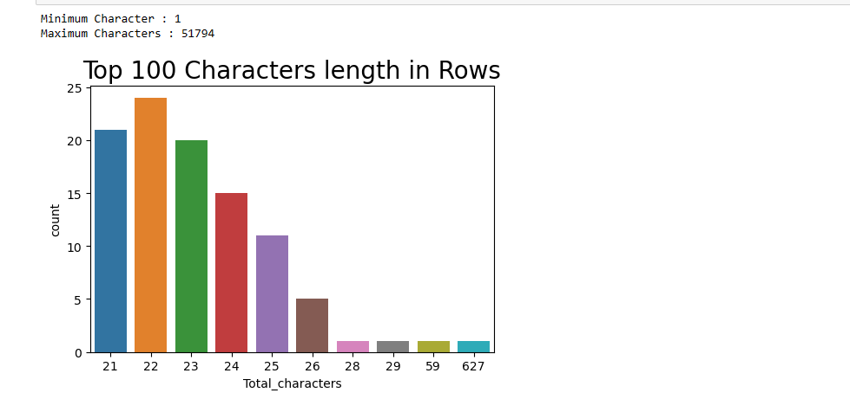
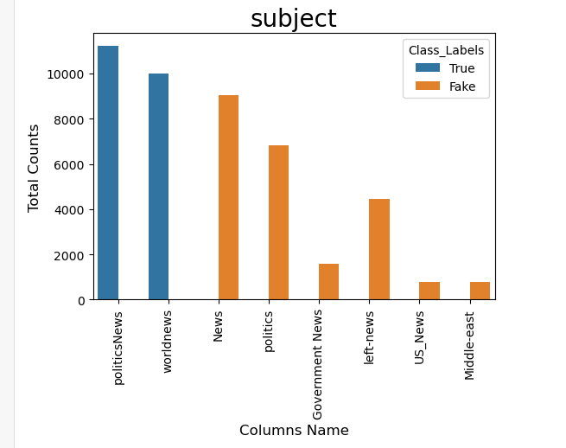
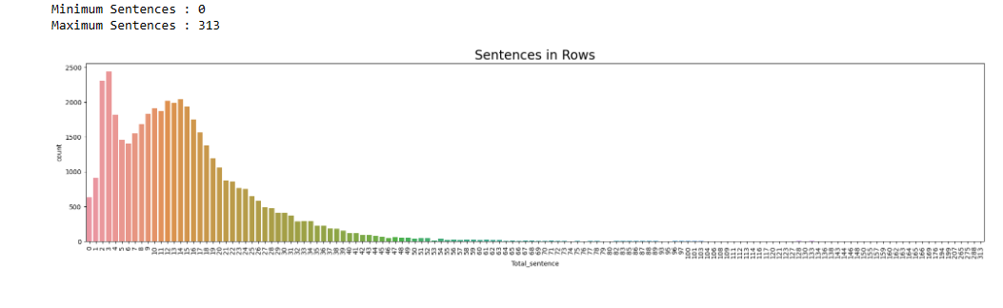

Slide 11
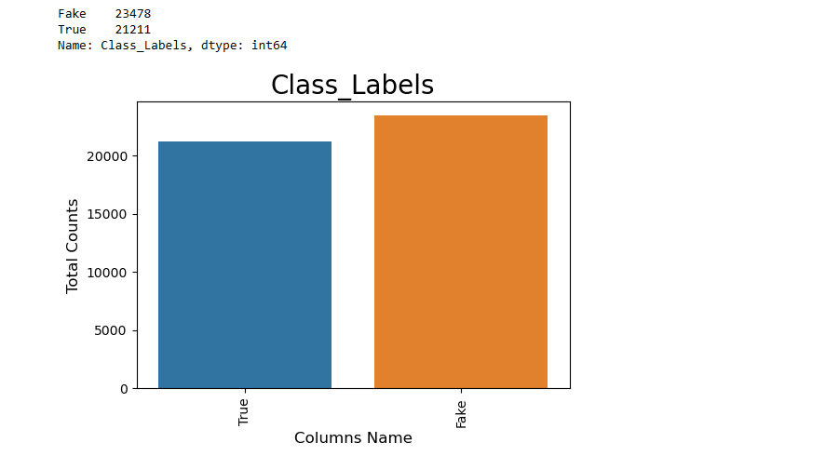
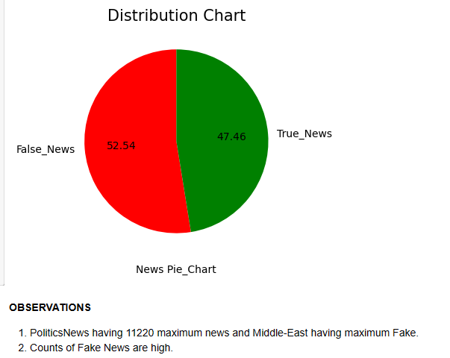

Slide 12
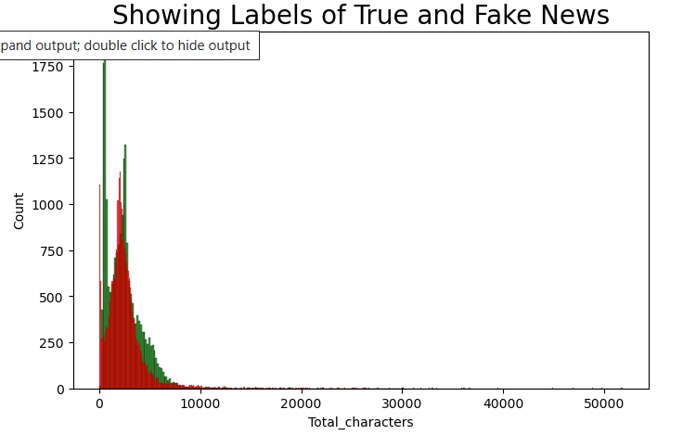
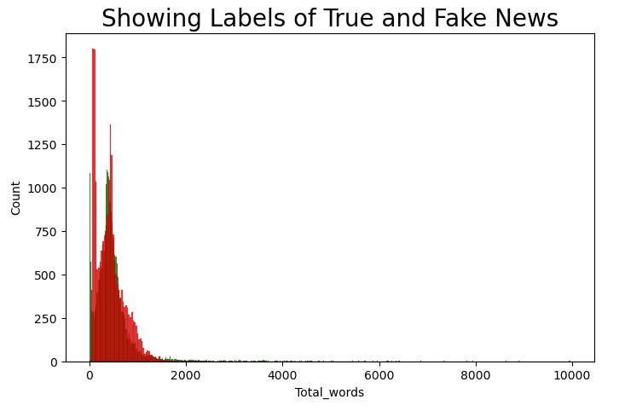
TOTAL CHARACTERS
TOTAL WORDS

Slide 13
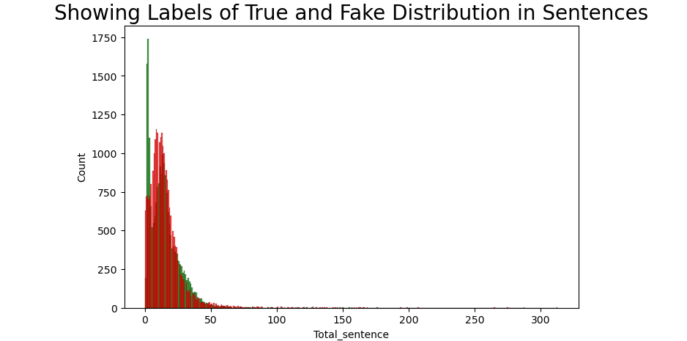
FEW VISUALIZATION

Slide 14
Observation:
Column consist of 44898 rows and 5 columns, 2D data with 1.8 MB size.
Almost more than Null percent data is missing in the columns.
Found 209 Duplicated Row, Hence dropped
Rude column shows 23478 FAKE NEWS and 21211 TRUE NEWS
Length of Total Characters, Total Words, Total Sentences.
Total Characters shows maximum between 240 to 380.
Total Words shows Maximum lies between 500 words.
Maximum spam sentences likes at 11 TO 15.
Total Words and Total Sentences are highly correlated with target

Slide 15
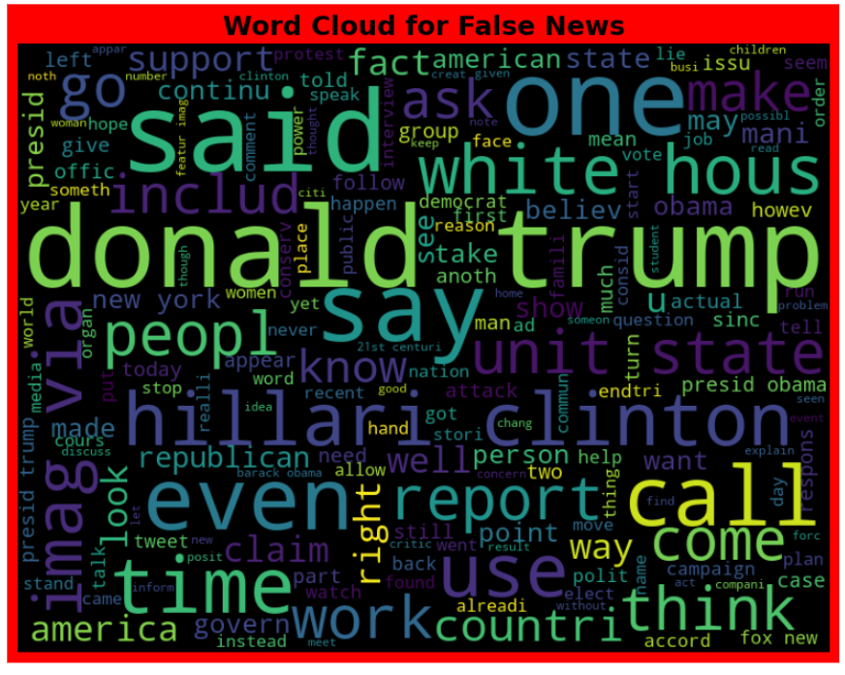
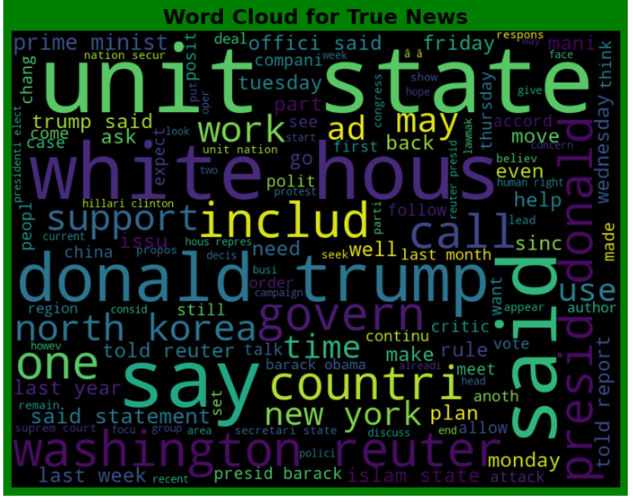

Slide 16
DATA ANALYSIS:
I have used count plot , bar plot and cat plot to show the relationship between numerical variable.
Other than these, I used Word Cloud to see the frequency of words. In each columns and found maximum contains of those words within.
I have used NLTK library for Natural Language processing. The other than key was used while removing all the abnormal symbols from independent Variable.
I found the contains of distribution with the help of Pie chart. An Extra count graph was also drawn to show the distribution.
We have focused on the length of words, sentences and characters while working with data set
Stop words was also used with string punctuation words to make the system more ready for classification.
We have used Stemming for FAKE NEWS classification as that help model to work in more better way.
We used Text frequency and Inverse Document Frequency for vectorization.

Slide 17
STEPS INVOLVED
Since Class Label was my target variable and it was a categorical column which I converted to 0 and 1.
However target variable has two value counts So this particular problem was Logistic regression problem and I have used all Classification algorithms to build my model.
I tried to focus more on NAIVE Based models, However the precision was not good we used other models to get the best.
By looking into the difference of PRECISION_ SCORE and ACCURACY_SCORE and cross validation I found Random Forest Classifier Model to be best. And I tried with Logistic Regression model to boost the model.
We used hyperparameter and increased the efficiency of few numbers. And finally saved the Random Forest Model..

Slide 18
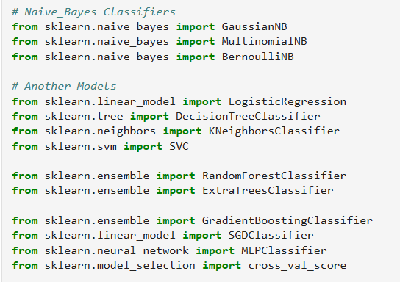
ALGORITHMS I HAVE USED IN MY PROJECT

Slide 19
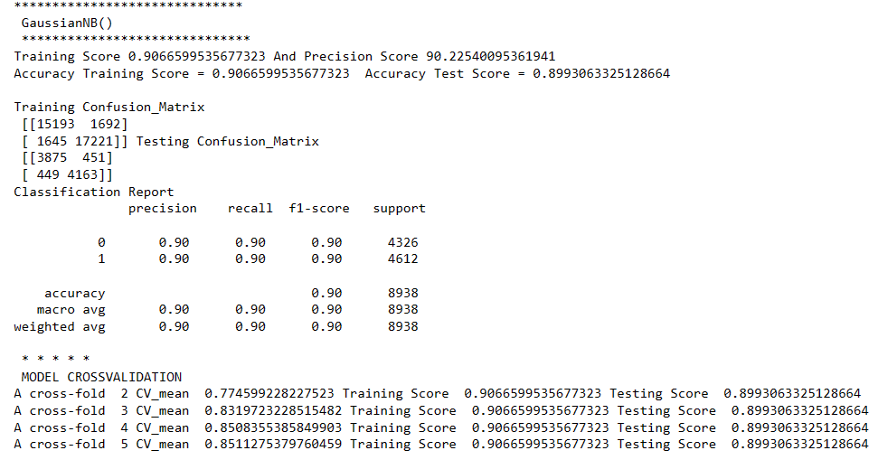
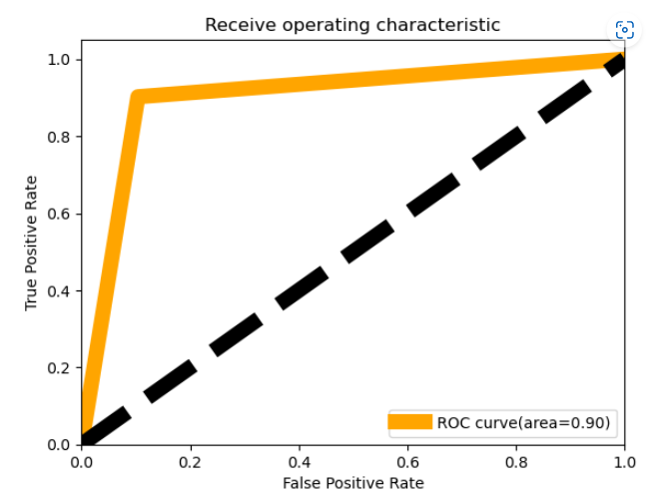
NAIVE BASE MODELS WITH THEIR PERFORMANCE

Slide 20
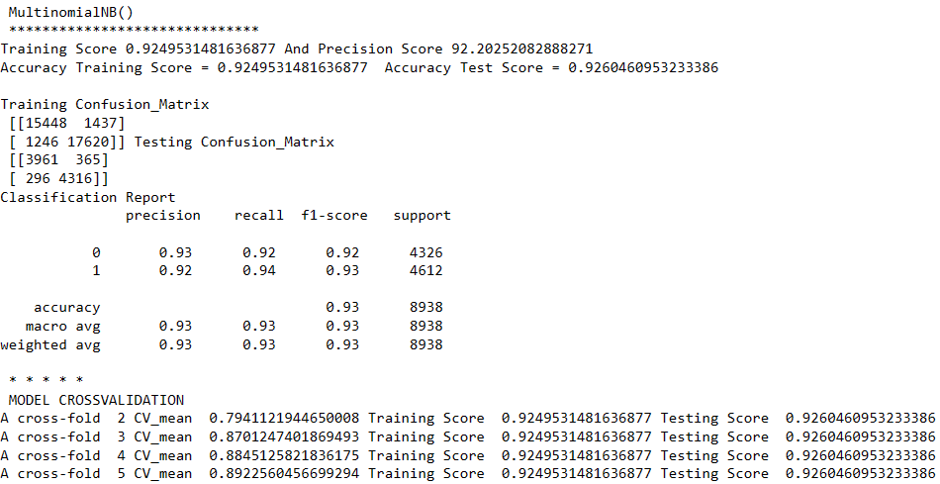
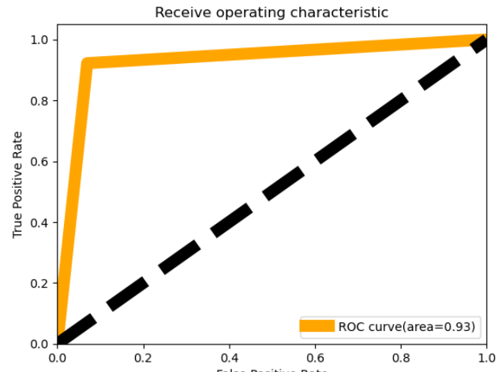
NAIVE BASE MODELS WITH THEIR PERFORMANCE

Slide 21
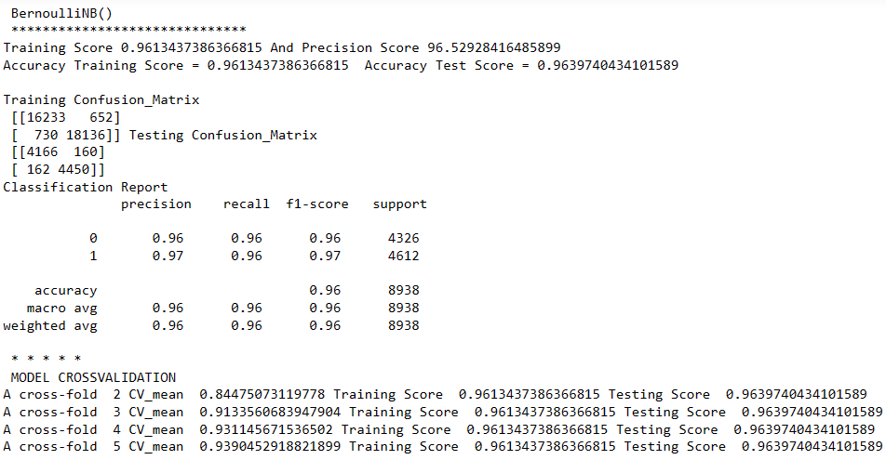
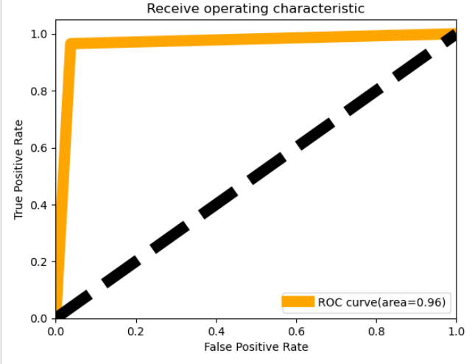
NAIVE BASE MODELS WITH THEIR PERFORMANCE

Slide 22
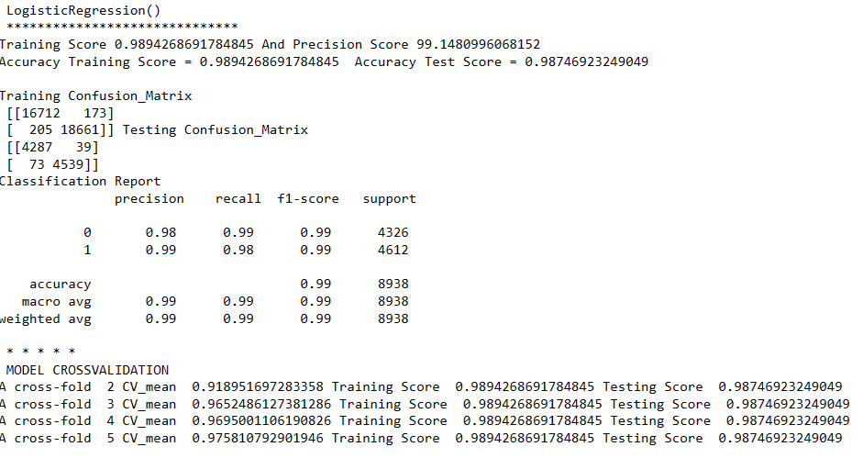
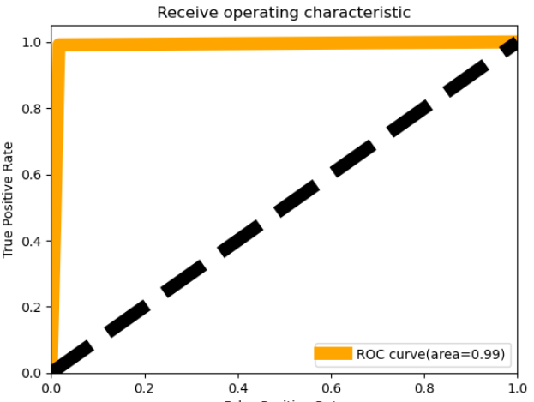
DIFFERENT MODELS WITH THEIR PERFORMANCE:

Slide 23
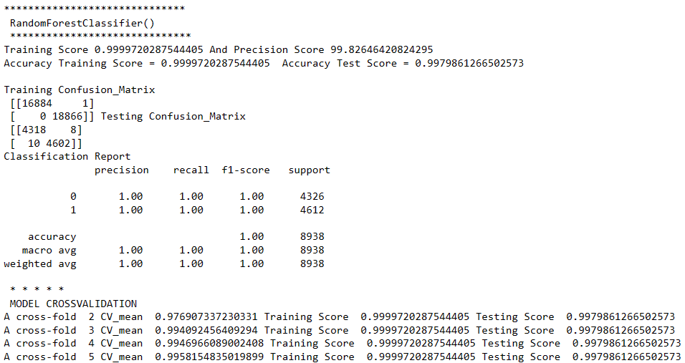
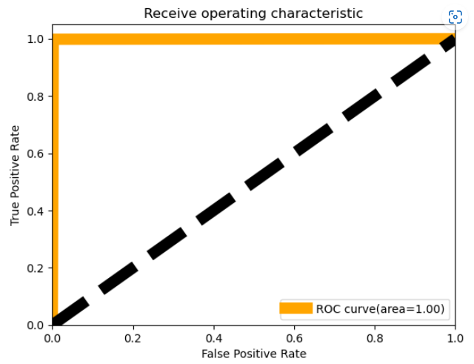
DIFFERENT MODELS WITH THEIR PERFORMANCE:

Slide 24
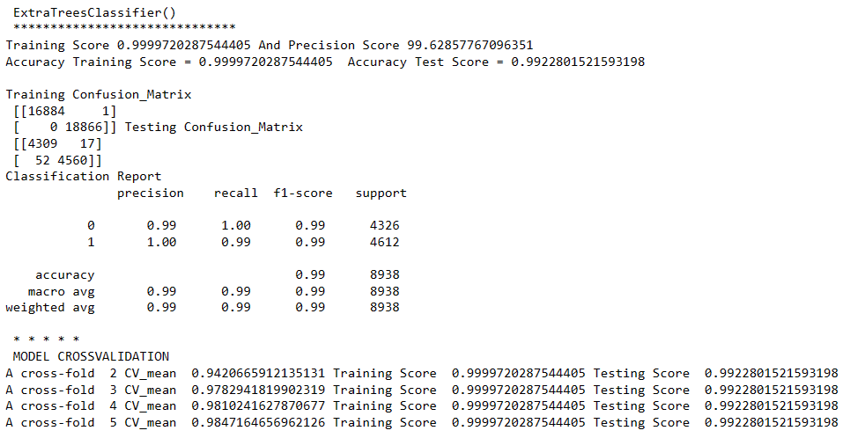
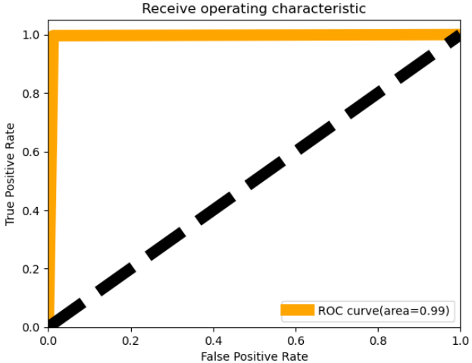
DIFFERENT MODELS WITH THEIR PERFORMANCE:

Slide 25
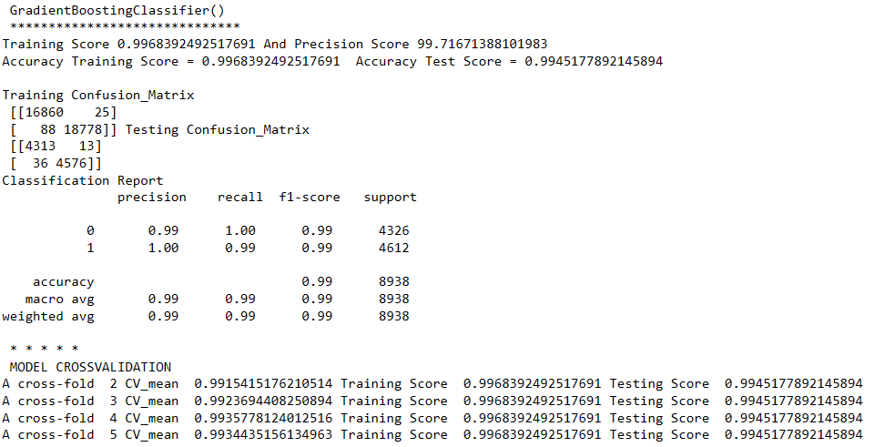
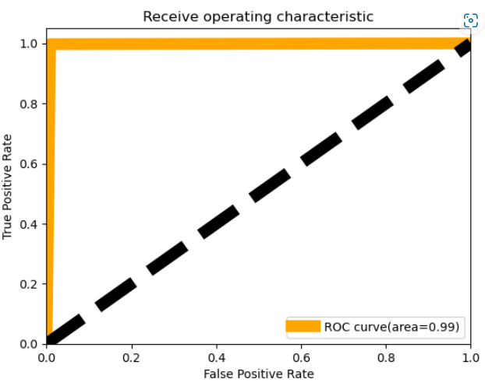
DIFFERENT MODELS WITH THEIR PERFORMANCE:

Slide 26
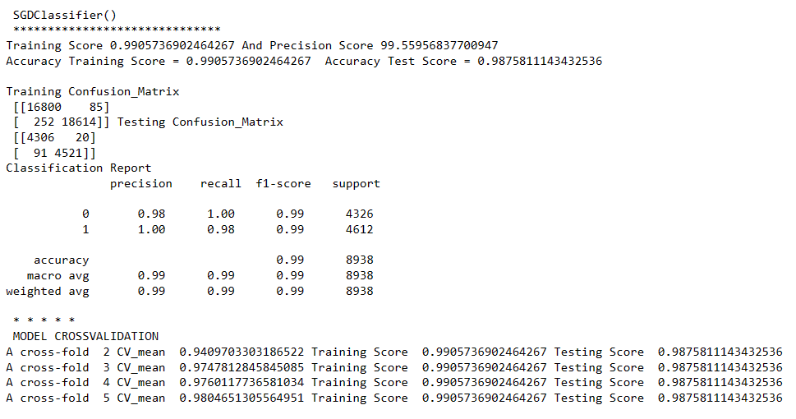
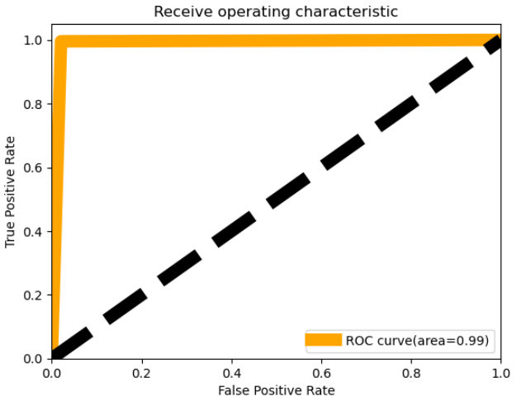
DIFFERENT MODELS WITH THEIR PERFORMANCE:

Slide 27
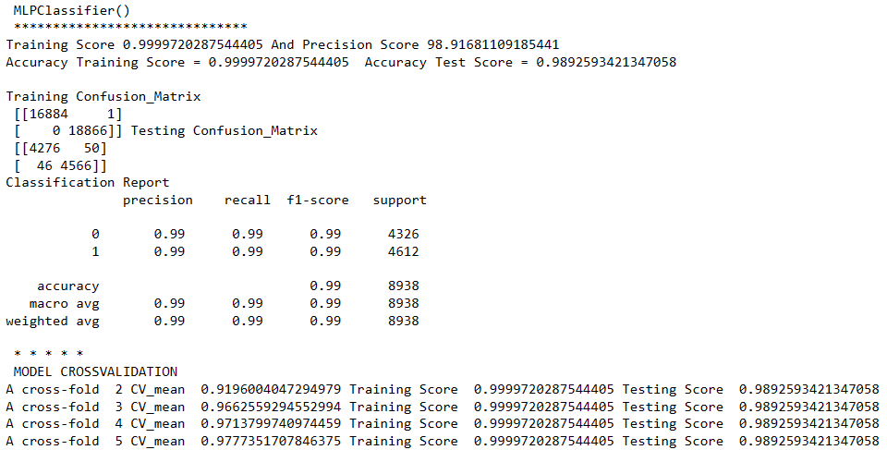
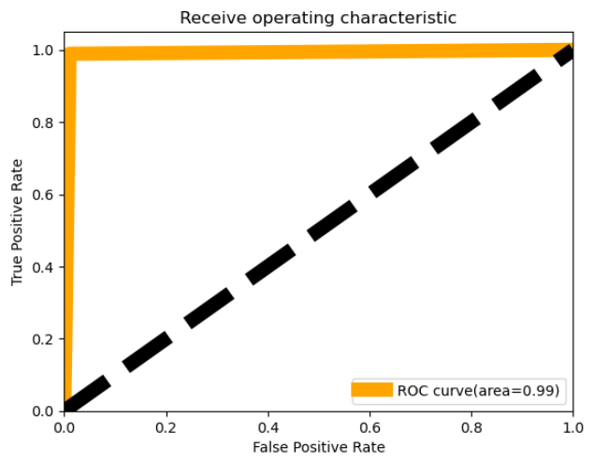
DIFFERENT MODELS WITH THEIR PERFORMANCE:

Slide 28
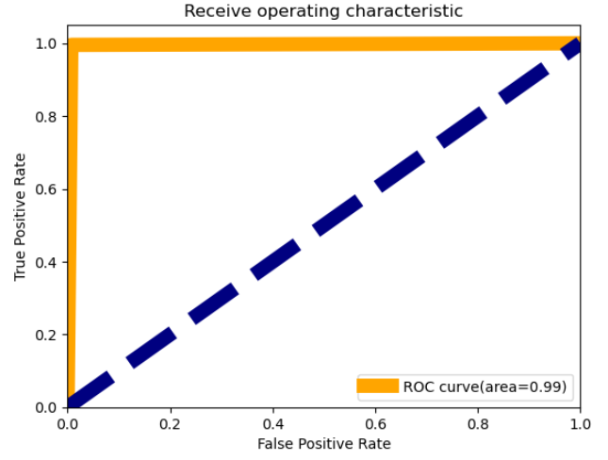
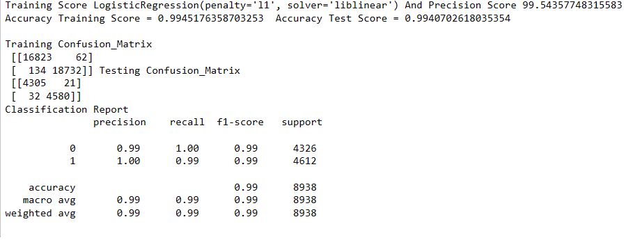
LOGISTIC REGRESSION : HYPER PARAMETER

Slide 29
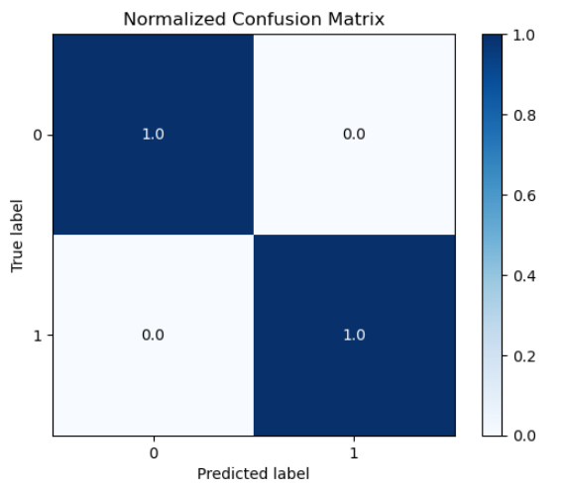
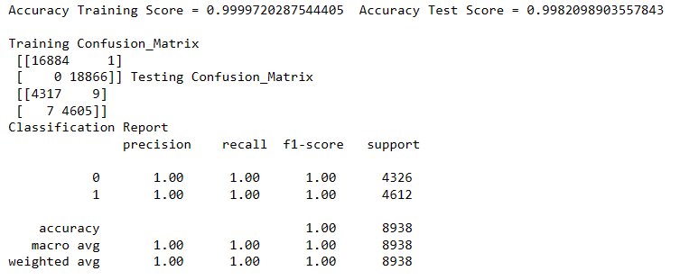
RANDOM FOREST : HYPER PARAMETER

Slide 30
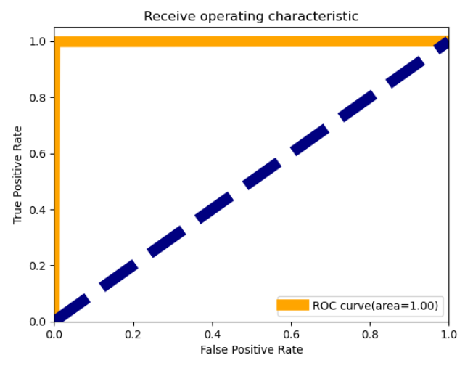
AOC_ROC GRAPH

Slide 31

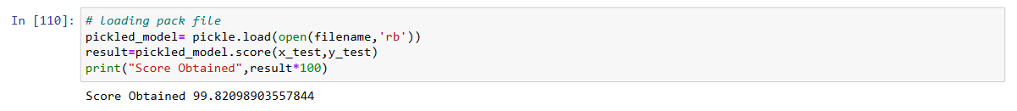
MODEL SAVING:
Model Loading Back:

Slide 32
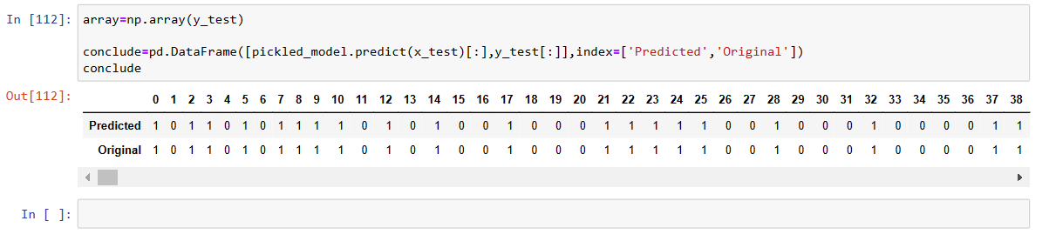
Prediction on Test Data AFTER SAVING:

Slide 33
CONCLUSION:
In this project report, We have used mainly NLTK library, ML algorithms and seaborn library to understand the relation and interpret the best result.
We have mentioned the step by step procedure to analyze of the Data Set .
Thus we can select the features which are not correlated and are independent in nature.
We calculated the performance of each model using different performance metrics and compared them based on these metrics.
Maximum model selection was focused based on precision Score and Model Accuracy. The Model that worked better on the basis of precision score and accuracy is Random Forest Classifier and Neural Networks Model MLP classifier.
There were very least numbers of feature present in our dataset, I analyzed the data and dropped all the necessary features and finally built the model on TEXT COLUMN and TARGET COLUMN.
From overall analysis and visualization I come into conclusion that , that text can be cleaned, pre-processed and turned into vectors and These vectors can be used in prediction of FAKE NEWS AND TRUE NEWS, Now a days, these has become a one the major source of Fraud, Many frauds can be stopped by this simple step.

Slide 34
Final Conclusion
I hope this model will help companies to classify the FAKE NEWS and TRUE NEWS.
To conclude, the application of machine learning model in FAKE NEWS classification is still at an early stage.
I hope this study has moved a small step ahead in providing some methodological and empirical basis contributions. I think and hope that this will help the consumers to detect Maximum fraud and Frauds can be brought down to some level within this model
Fake News Classification is one of the more challenging classification than SMS and SPAM Email detection.
Fake news research has never been more important than it is now. Especially during a time when the world is fighting a pandemic. The approaches explored in this article only scratch the surface. There are so many more approaches and criteria for fake news detection. Datasets also impact the accuracy of fake news detection tasks.
It is also worth noting that, as much as our focus is on automated approaches, the human element is key to this fight. A combination of human and automated approaches gives rise to a hybrid approach. I hope this Model challenges you to join the fight against fake news by creating better and greater solutions.

